Slide 1
Spiking Neural Networks and You
Brains and games

Slide 2
Introduction
Spiking Neural Networks are a variation of traditional NNs that attempt to increase the realism of the simulations done
They more closely resemble the way brains actually operate
They are yet to have a great impact in video games, but research is still being done

Slide 3
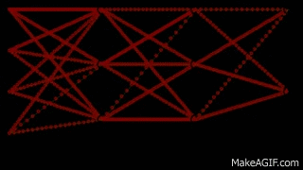
Representation
Very similar in structure to a standard Multilayer Perceptron Neural Network
Adds the element of time and changes how neurons fire
Neurons have potential which decays over time, but is increased when receiving a signal

Slide 4
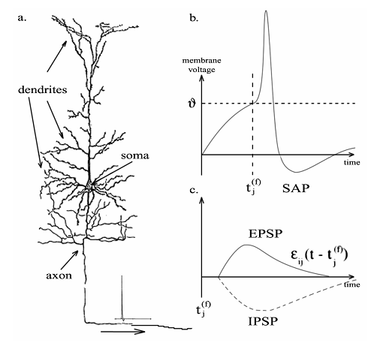
Neurons and how they fire
Signals a neuron receives increase its potential
When the potential of a neuron exceeds a threshold, it fires
Firing causes the neuron to go into a “cooldown” phase
Once the “cooldown” phase is over, the neuron can start receiving signals again

Slide 5
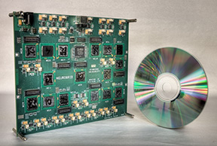
Hardware
There are pieces of hardware dedicated to running neural networks, particularly spiking neural networks

Slide 6
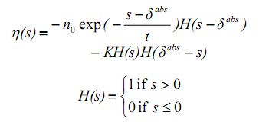
Math (1)
the effect of an excitatory postsynaptic potential
the period of relative refractoriness, called the negative spike after-potential

Slide 7
Math (2)
the effects on membrane potential u over time
Integrate-and-fire neurons input calculation

Slide 8
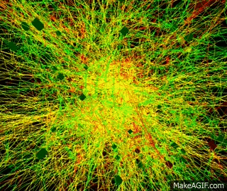
Complexity
Spiking Neural Networks simulate real brain activity
The visual representation is really interesting on its own

Slide 9
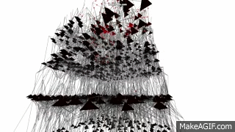
Spiking Neural Networks as art
There doesn’t seem to be any research on aesthetic applications of these visualizations, but they’re pretty

Slide 10
Spiking Neural Networks in Games

Slide 11
Research done
Most common application, at the time of writing, for SNNs is to simulate believable agents for various tasks
A common task is creating a human-like racing game AI driver
Another application is the training of good FPS bots
A final area that will be discussed is training AI players for simple video games

Slide 12
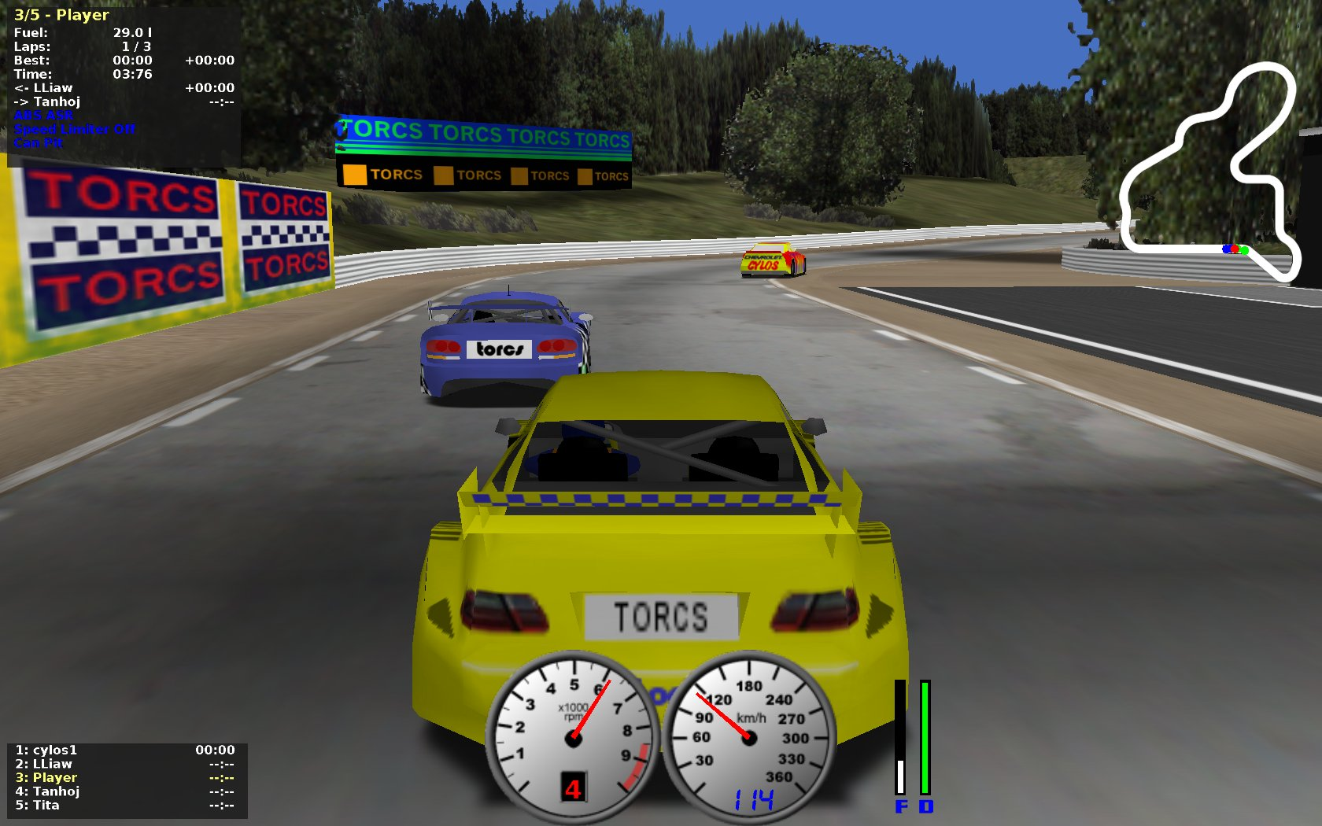
Racing the world (1)
SNNs used to learn how to race, then compete, in TORCS, an open source racing simulator
Results have been deemed to be very promising
Authors believe SNNs could be used in more game types

Slide 13
Racing the world (2)
When it comes to racing games, current research shows no palpable difference between multilayer perceptron neural networks and SNNs
SNNs seem to be more capable of handling new scenarios (different race tracks compared to the training racetrack), but don’t overperform on known racetracks

Slide 14
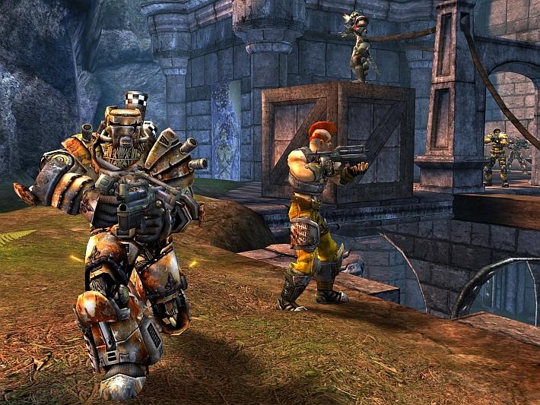
Competing in the Unreal (1)
Creating believable enemies that don’t cheat in first person shooters is also greatly desirable
An Imperial student created an agent to play Unreal Tournament 2004 using an SNN for the BotPrize 2011 competition
The agent did very well (2nd), but failed to be considered “human” by the evaluation technique used

Slide 15
Competing in the Unreal (2)

Slide 16
Training agents for simple games
Often used to train agents for the purpose of demonstrating hardware, rather than furthering games
Thibeault, Harris and Srinivasa used SNNs to play Pong and a simple first person selection game to showcase neuromorphic chips (DARPA SyNAPSE)
The existence of optimized Neural Network hardware offers great potential for dedicated game agents in the future

Slide 17
Summary
Neural Networks are really strong and interesting
Spiking Neural Networks go one step further in complexity, for potential better results
This is, essentially, a brain telling you brains and their digital cousins are cool. Your brain agrees

Slide 18
Sources (1)
Spiking Neural Networks for Human-like Avatar Control in a Simulated Environment - Zafeirios Fountas (Imperial College MSc Dissertation)
Spiking neural network vs multilayer perceptron: who is the winner in the racing car computer game - Urszula Markowska-Kaczmar, Mateusz Koldowski (Springerlink.com)
Spiking neural networks, an introduction - Jilles Vreeken (https://people.mmci.uni-saarland.de/~jilles/)

Slide 19
Sources (2)
Using Games to Embody Spiking Neural Networks for Neuromorphic Hardware - Thibeault, Harris and Srinivasa (IJCA, Vol. 21, No. 1, March. 2014)
Evolutionary Spiking Neural Networks as Racing Car Controllers – Elias E. Yee and Jason Teo (International Journal of Computer Information Systems and Industrial Management Applications, Volume 5 (2012) pp. 365-372)
https://www.youtube.com/watch?v=T2aZAWXyw6c
https://www.youtube.com/watch?v=Blegbge7ri8
https://www.youtube.com/watch?v=HM44jlL8U_M

